Slide 1
Child Poverty and Social Exclusion
Jonathan Bradshaw
Research Seminar
The State of the Art of Measuring Poverty and Social Exclusion in the UK and Japan
IPSS
Tokyo
January 6 2012

Slide 2
State of child poverty is not good
In the UK child poverty targets missed – child poverty now increasing again – no chance of meeting 2020 target
In Japan child poverty higher than UK according to latest data
All but seven OECD countries increased their child poverty 1995-2005
In EU 2005-2009 child poverty increased in SE, DE, FR,IT, GR and IE
Child poverty higher than pensioner poverty in most countries
In developing world despite economic growth – child poverty flat lining.

Slide 3
Outline
Measurement of child poverty in the
  UK
  EU (and OECD)
Shift from income to deprivation
  PSE surveys
  EU SILC
Shift from poverty to material well-being
Asking children
Well-being

Slide 4
(Official) Child Poverty measurement in the UK
Relative low income = Equivalised net household income less than 60% median
  2020 target: <10% of children
Combined low income and material deprivation = Material deprivation >20% and equivalised net household income less than 70% median
  2020 target: <5% of children
‘Absolute’ low income= Equivalised net household income falling below 60% of the ‘adjusted base amount’
  2020 target: <5% of children
Persistent poverty= Equivalised net household income less than 60% of median for 3 years prior to current year
    2020 target: not yet set

Slide 5
Child Poverty in the EU and rich nations
Sources:
  OECD Growing unequal - every five years (sooner)
  Luxembourg Income Study - every five years
  EU SILC now annually
EU social inclusion indicators from SILC – child poverty key focus
  At risk of poverty rate<40,50,60,70% of national median
  At risk of poverty gap 60%
  <60% anchored
  Lacking 3+ (out of 9) deprivation items
  Persistent – to be developed
  Now 2020 target =<60% median or lacking 4+ deprivation items or workless
SILC 2009 includes special module on child poverty/well-being

Slide 6
Child poverty rates in the OECD (<50% median) circa 2008 –UNICEF Innocenti Report Card 10

Slide 7
Child poverty gaps in OECD circa 2008

Slide 8
Child poverty rates circa 2008
 |  | Poverty Line at 50 per cent | Poverty Line at 40 per cent | Poverty Line at 60 per cent
1 | Iceland | 4.7 | 1.9 | 10.1
2 | Finland | 5.3 | 1.5 | 11.9
3 | Cyprus | 6.1 | 1.8 | 12.1
4 | Netherlands | 6.1 | 2.9 | 15.4
5 | Norway | 6.1 | 3.1 | 11.3
6 | Slovenia | 6.3 | 2.9 | 11.1
7 | Denmark | 6.5 | 3.6 | 11.4
8 | Sweden | 7.3 | 3.7 | 12.7
9 | Austria | 7.3 | 3.2 | 13.6
10 | Czech Republic | 7.4 | 3.8 | 13.0
11 | Switzerland | 8.1 | 3.2 | 17.9
12 | Ireland | 8.4 | 3.5 | 18.9
13 | Germany | 8.5 | 4.6 | 14.9
14 | France | 8.8 | 3.7 | 16.8
15 | Malta | 8.9 | 2.9 | 20.3
16 | Belgium | 10.2 | 4.1 | 16.6
17 | Hungary | 10.3 | 3.0 | 20.6
18 | Australia | 10.9 | 4.3 | 17.6
19 | Slovakia | 11.2 | 6.6 | 17.0
20 | New Zealand | 11.7 |  | 19.4
21 | Estonia | 11.9 | 6.1 | 20.6
22 | United Kingdom | 12.1 | 5.6 | 20.8
23 | Luxembourg | 12.3 | 4.2 | 22.4
24 | Canada | 13.3 | 7.3 | 21.9
25 | Poland | 14.5 | 7.5 | 22.9
26 | Portugal | 14.7 | 9.6 | 22.7
27 | Japan | 14.9 | 9.6 | 20.5
28 | Lithuania | 15.4 | 8.8 | 24.3
29 | Italy | 15.9 | 9.7 | 24.2
20 | Greece | 16.0 | 8.1 | 23.5
31 | Spain | 17.1 | 11.5 | 23.6
32 | Bulgaria | 17.8 | 12.2 | 24.4
33 | Latvia | 18.8 | 12.8 | 25.0
34 | USA | 23.1 | 16.6 | 31.1
35 | Romania | 25.5 | 17.8 | 32.3

Slide 9
Child poverty higher than pensioner poverty in most countries (but not Japan)

Slide 10
Child poverty much higher in lone parent families especially in Japan

Slide 11
Transfers reduce child poverty but not by much in Japan

Slide 12
Problems with relative income poverty measure
Income indirect indicator
Reporting unreliable – gifts, dissavings, home produce
Threshold arbitrary – usually relative and too low in poor countries
Equivalence scale no basis in science
Deprivation more direct

Slide 13
From income to deprivation
Peter Townsend Poverty in the UK
Mack and Lansley Breadline Britain
PSE x 2
Aya Abe in Japan
Child deprivation index in PSE 1999 not very discriminating
  Every item a necessity
  Lacking 1 or more the threshold

Slide 14
Items: PSE 2011
From PSE99 (items considered necessities and lacked by 3%+):
Celebrations on special occasions
Hobby or leisure activity
Educational games
Meat, fish or vegetarian equivalent at least twice a day
Bedroom for every child of different sex over 10 years
At least 4 pairs of trousers
Swimming at least once a month
Garden to play in
Some new, not second hand, clothes
Construction toys
Holiday away from home at least one week a year
Bike (new/second hand)
Leisure equipment
Friends round for tea/snack fortnightly
For consideration from PSE99:
At least 50p a week for sweets (considered necessary by poorer parents)
Computer suitable for schoolwork (considered necessary by poorer parents, more universal now)
Computer games (more universal now)
From FRS 2008-9 (higher proportion lacking than in 1999):
Play group at least once a week
School trip at least once a term

Slide 15
Items: PSE 2011
From EU SILC:
A suitable place to study or do homework
Access to all the GP/specialist treatment needed
Access to all the dental examinations/treatment needed
From Children’s Society:
Pocket money
Money to save
Designer/brand name trainers
Treats/snacks once a week
Being part of a club
iPod/similar
Mobile phone
Computer and internet
Games console
Cable/satellite TV
Their own bedroom
Presents on special occasions
A family car
Access to public transport
Clothes to fit in with their peers
Books of their own
Day trips with their family once a month

Slide 16
SILC 2009 child deprivation indicators. Items dropped for UNICEF index
Clothes: Some new (not second-hand) clothes
Shoes: Two pairs of properly fitting shoes (including a pair of all-weather shoes)
Fruit: Fresh fruit and vegetables once a day
Three meals: Three meals a day
Meat: One meal with meat, chicken or fish (or vegetarian equivalent) at least once a day
Books: Books at home suitable for their age
Leisure: Regular leisure activity (swimming, playing an instrument, youth organization etc.)
Equipment: Outdoor leisure equipment (bicycle, roller skates, etc.)
Outdoor: Outdoor space in the neighbourhood where children can play safely
Games: Indoor games (educational baby toys, building blocks, board games, etc.)
Festivity: Festivity on special occasions (birthdays, name days, religious events, etc.)
Friends: Invite friends around to play and eat from time to time
School trips: Participate in school trips and school events that cost money
Home work: Suitable place to study or do homework
Internet
Holidays: Go on holiday away from home at least 1 week per year
Unmet need for GP specialist
Unmet need for dentist

Slide 17
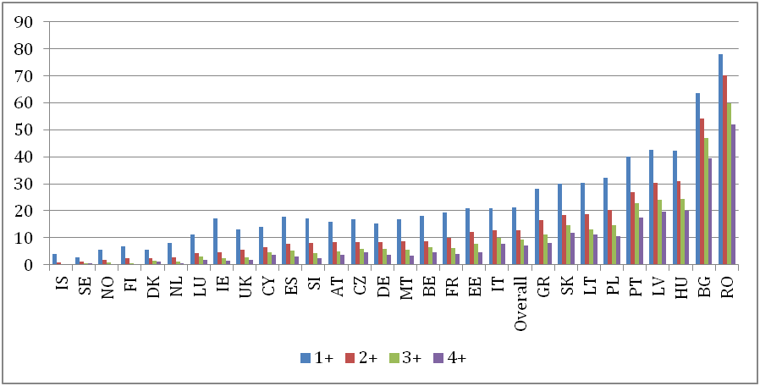
% children lacking deprivation items

Slide 18
% Children poor and deprived

Slide 19
Two developments
Children as respondents
  Children actors in their own lives
  Children deprived in rich households and not deprived in poor households
  Closer association with child well-being
Broader conceptions
  Bristol Social Exclusion matrix (B-sem)
  Child well-being

Slide 20
Child deprivation measure
List of 20 items identified in focus groups. Reduced through pilot data to list of 10, based on scalability and strength of relationship to traditional poverty variables
10 items included in main-stage and quarterly surveys:
  Some pocket money each week
  Some money to save each month
  A pair of brand-named trainers
  An iPod or similar MP3 player
  Cable or satellite TV at home
  A garden or somewhere similar nearby to spend time safely
  Access to a family car
  Clothes to fit in with other people their age
  A holiday away from home for one week each year
  Monthly day-trips with family

Slide 21
Children’s Society surveys
In a sample of 1800 children aged 10-15 we found that
  43% of children living in families in the lowest equivalent income quintile were deprived on 1 or fewer items. Non deprived poor.
  However there were 12% of those in the highest quintile deprived on 3+ items and 2% deprived on 5+ items. These are deprived children in rich households. Non poor but deprived

Slide 22
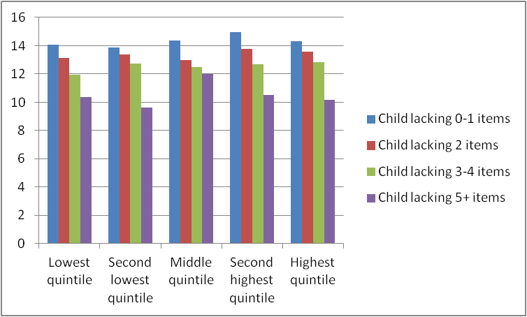
Child subjective well-being varies more by child deprivation than parental income

Slide 23
OECD Doing Better for Children (2009)

Slide 24
Child income poverty and child well-being

Slide 25
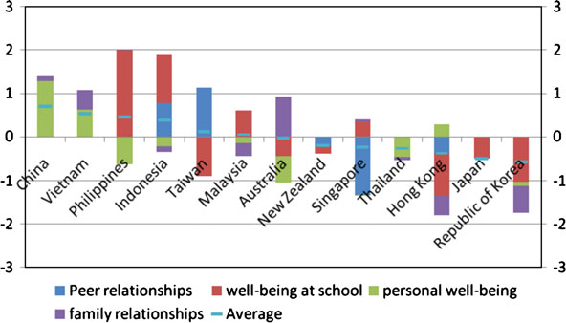
Subjective well-being in the Pacific Rim

Slide 26
The End
jonathan.bradshaw@york.ac.uk
http://www-users.york.ac.uk/~jrb1/

